Slide 1
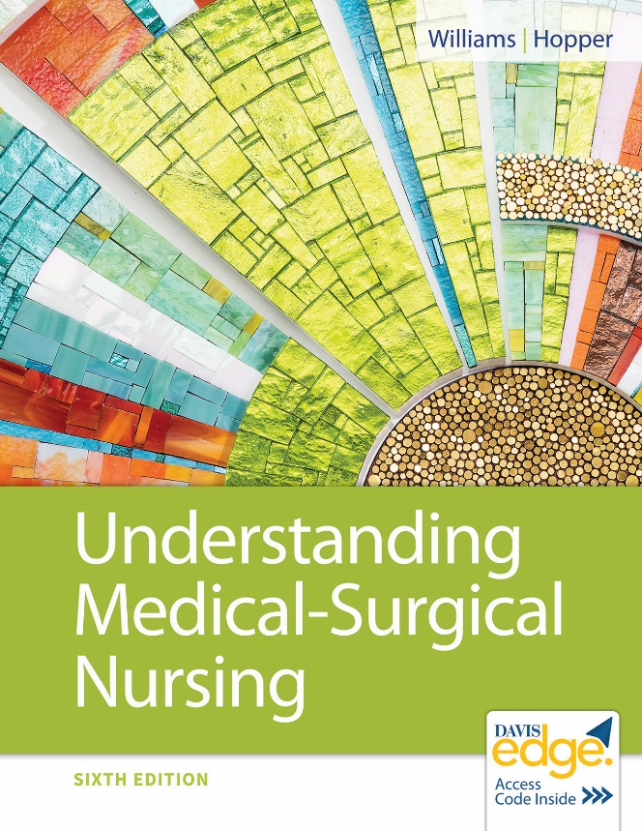
Chapter 8
Nursing Care of Patients With Infections

Slide 2
Learning Outcomes
List the links in the chain of infection.
Explain how to interrupt the routes of transmission for infections.
Describe the body’s defense mechanisms to fight infection.
Describe the principles of anti-infective medication administration.
Describe nursing care for a patient with an infection.

Slide 3
Infection Process
Chain of infection required
Six links in the chain
Treatment breaks the chain

Slide 4

Chain of Infection

Slide 5
Link 1: Infectious (Causative) Agents
Bacteria
Virus
Fungi
Protozoa
Helminth
Prion

Slide 6
Key Terms
Microbiota: Microbes occurring naturally in a body part
Pathogen: Disease-causing microbe

Slide 7
Link 2: Reservoir
Environmental home for infectious agents
Animate: People, insects, animals, plants
Inanimate: Water, soil, medical devices

Slide 8
Link 3: Portal of Exit
Path by which infectious agent leaves its reservoir

Slide 9
Link 4: Mode of Transmission
Direct
Indirect

Slide 10
Direct
Direct contact
Touching
Kissing
Sexual contact
Droplet spread
Sneezing
Coughing
Talking
Disease examples
Scabies
Infectious mononucleosis
Sexually transmitted infections
Pertussis
Influenza

Slide 11
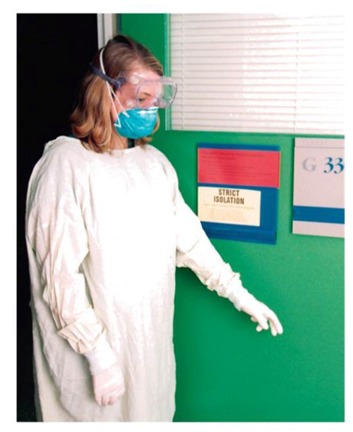
Direct (continued)
Prevention
Hand hygiene
Aseptic technique
Personal protective equipment (P P E)
Gloves
Surgical masks
Goggles
Gowns
Shoe covers

Slide 12
Indirect
Vehicle-borne transmission by contact with contaminated object
Vehicle examples
Toys, bedding, dressings, surgical instruments
Biological: Blood, organs
Water/food
Disease examples
Influenza, norovirus, hepatitis
Prevention
Hand hygiene, stethoscope cleaning
Cleaning per protocols
Clean water/food

Slide 13
Indirect (continued_1)
Vector-borne transmission by living source other than humans
Vectors: Fleas, mice, mosquitos, rats, ticks
Disease examples
Lyme disease, malaria, plague, Zika
Prevention: Insect repellents, rodent control

Slide 14
Indirect (continued_2)
Airborne transmission
Dust or droplet nuclei carry pathogen through air
Small particles in air for long time and large distance Inhaled/deposited on host mucous membranes
Disease examples: Measles, chickenpox, tuberculosis
Prevention
High-efficiency particulate air (H E P A) respirators

Slide 15
Be Safe!
Airborne transmission
Must have your own fit-tested H E P A respirator.
Do not enter a patient’s room without a fit-tested H E P A respirator.
Surgical masks do not protect!

Slide 16
Link 5: Portal of Entry
Entry into susceptible host
Portals
Respiratory tract
Skin
Mucous membranes
Gastrointestinal tract
Genitourinary tract
Placenta

Slide 17
Link 6: Susceptible Host
Occurs from defense breakdown
Increased risk
Burns
Chronic disease
Immunocompromised
Invasive procedures
Malnourishment
Stress
Young or old age

Slide 18
Body’s Defense Mechanisms
Skin and mucous membranes
Cilia
Gastric acid
Immunoglobulins
Leukocytes and macrophages
Lysozymes
Interferon
Inflammatory response

Slide 19
Inflammatory Response
Vascular response
Inflammatory exudate
Phagocytosis and purulent exudate

Slide 20
Immune System
Body’s final defense against infection
Immune cells and lymphoid tissue

Slide 21
Infection
Results when immune system protection fails

Slide 22
Localized Infection
Microbes in one area
Pain, redness, swelling, site warmth

Slide 23
Sepsis
Dysregulated host response to infection
Can be life-threatening
Organ damage
Can lead to septic shock
Decreased blood pressure

Slide 24
Laboratory Assessment
Gram staining
Culture and sensitivity (C&S)
Antibody test
Complete blood count (C B C) with differential
Erythrocyte sedimentation rate (E S R)

Slide 25
Immunity
Ability of body to protect itself from disease
Natural immunity
Species specific
Innate immunity
Hereditary
Acquired immunity
Exposure
Vaccination
Immunoglobulin injection

Slide 26
Infectious Disease Examples
Infectious mononucleosis
Epstein-Barr virus usual cause
Contagious (“kissing disease”)
Symptomatic in teens, young adults
Extreme fatigue, anorexia, chills, red sore throat, headache, high fever, tonsils with a white coating
Supportive care

Slide 27
Infectious Disease Examples (continued_1)
Ebola virus disease
Direct contact transmission
Use hand hygiene, specialized P P E
Symptoms appear in 2 to 21 days
Fever, headache, diarrhea, vomiting, abdominal pain, muscle pain, unexplained bruising/bleeding
Supportive care only
Complications: Joint and vision problems

Slide 28
Infectious Disease Examples (continued_2)
Zika virus disease
Transmitted by infected aedes species mosquitos
Use hand hygiene, contact precautions
Symptoms: Fever, headache, rash, muscle/joint pain, conjunctivitis
Supportive care: Acetaminophen, fluids, rest
Complications: Guillain-Barre syndrome, birth defects

Slide 29
Community Infection Control
World Health Organization
Centers for Disease Control and Prevention
Local health departments
Home health nurses

Slide 30
Infection Control in Health Care Agencies
Community-acquired infection
Health care associated infection (H A I)

Slide 31
Health Care Associated Infections
Infection from care in health care agency
Risk factors
Host’s condition
Multiple antibiotic therapy
High-risk units
Common pathogens
Escherichia coli
Staphylococcus aureus
Pseudomonas aeruginosa

Slide 32
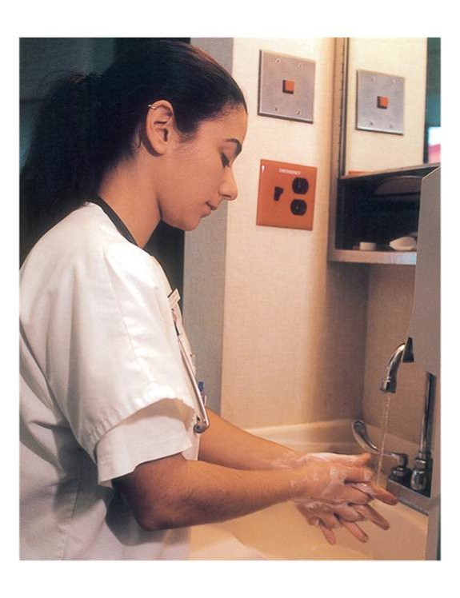
Hand Hygiene
Before and after
Patient contact
Glove use

Slide 33
Hand Hygiene (continued_1)
Proper hand hygiene
Wet hands with clean running water.
Soap, lather 20 seconds (hum “Happy Birthday” twice).
Interlace fingers.
Clean nails against palms.
Rinse with fingertips downward.
Dry with paper towels.
Turn off faucet with towel.

Slide 34
Hand Hygiene (continued_2)
Proper use of alcohol-based hand rubs
Apply to palm of one hand.
Rub both hands together.
Cover all surfaces until hands completely dry.
Do not wash off hand rub.

Slide 35
Asepsis
Freedom from organisms
Medical asepsis
Clean technique
Surgical asepsis
Sterile technique

Slide 36
Ultraviolet (U V) Environmental Disinfection
U V light used to disinfect patient care areas and rooms after traditional cleaning

Slide 37
Infection Prevention
Standard precautions
Assume all patients infectious
Blood, body fluids, body substances
Hand hygiene, gloves, gowns, masks, goggles, face shields
Transmission-based precautions
Specific infectious diseases
Used with standard precautions

Slide 38
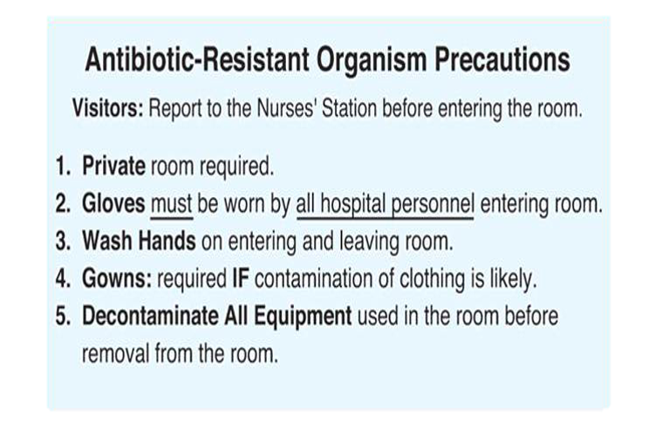
Infection Prevention Example
Precautions for vancomycin-resistant enterococci (V R E)

Slide 39
Prevention of Respiratory Tract Infections
Risk factors
Invasive tubes
Prevention
Oral hygiene
Coughing and deep breathing
Ventilator-associated pneumonia (V A P) bundles

Slide 40
Prevention of Genitourinary Tract Infections
Risk factors
Urinary catheters
Prevention
Appropriate use of urinary catheters
Intermittent catheterization
Strict aseptic technique
Secure tubing as directed
Closed system
Drainage bag below bladder level

Slide 41
Prevention of Surgical Wound Infections
Sterile technique for dressing changes
Monitor wound

Slide 42
Antibiotic-Resistant Infections
Methicillin-resistant Staphylococcus aureus (M R S A)
Difficult to treat
High mortality rate
Treatment: Vancomycin hydrochloride

Slide 43
Antibiotic-Resistant Infections (continued)
V R E
Direct/indirect transmission
Difficult to treat
Treatment: Combination antibiotic therapy
Isolation when hospitalized

Slide 44
Treatment of Infections
Type of organism guides drug selection
Antibiotics: Bacterial infections
Antivirals: Viral infections
Antifungals: Fungal infections
Monitor peak/trough levels

Slide 45
Antibiotic-Associated Diarrhea (A A D)
Upset of balance of natural gut microbiota
Harmful bacteria increase
Toxins cause inflammation
Watery stools result
May resolve when antibiotic stopped

Slide 46
Clostridium Difficile
Gram-positive bacterium
Overgrowth with imbalance in normal gut microbiota
Often from antibiotic therapy
Serious cause of A A D
Pseudomembranous colitis, a life-threatening condition, may result

Slide 47
Clostridium Difficile (continued)
Transmitted by the fecal–oral route
Hand washing essential
Alcohol-based rubs not effective
Antibiotic treatment stopped
Treatment: Metronidazole (Flagyl) or vancomycin (Vancocin)

Slide 48
Fecal Microbiota Transplantation
Treatment for C. difficile infection
Restores healthy gut bacteria
Rapid, dramatic results to restore health
Screened healthy donated feces
Transplanted via colonoscopy, sigmoidoscopy, nasogastric or nasoenteric tube, enema, esophagogastroduodenoscopy, or oral capsules

Slide 49
Fecal Microbiota Transplantation (continued)
Stool substitutes under study
Purified intestinal bacterial cultures
More acceptable to patients

Slide 50
Nursing Responsibilities
Check allergies.
Monitor side effects.
Check for signs of superinfection.
Monitor peak/trough levels.

Slide 51
Patient Education
Take all medication as prescribed.
Report side effects.

Slide 52
Nursing Diagnoses
Risk for Infection
Deficient Knowledge

Slide 53
Respiratory Tract Infections
Data collection
Signs and symptoms
Sputum culture
Nursing diagnosis
Risk for Infection

Slide 54
Respiratory Tract Infections (continued_1)
Implementation
Coughing and deep breathing
Oral care: Toothbrush or suction-type toothbrush and fluoride toothpaste
Hydrate.
Manage pain.
Elevate head of bed 30 degrees or more for tube feeding.

Slide 55
Respiratory Tract Infections (continued_2)
Evaluation
Oxygen saturation above 90%
Decreased dyspnea
Respirations not labored
Free of infection signs/symptoms

Slide 56
Gastrointestinal Tract Infections
Data collection
Signs and symptoms
Dehydration
Stool culture
Nursing diagnosis
Risk for Infection

Slide 57
Gastrointestinal Tract Infections (continued)
Implementation
Hydrate.
Follow standard precautions.
Evaluation
Free of infection and gastrointestinal symptoms

Slide 58
Genitourinary Tract Infections
Data collection
Signs and symptoms
Urinalysis
Urine culture
Nursing diagnosis
Risk for Infection

Slide 59
Genitourinary Tract Infections (continued)
Implementation
Avoid use of urinary catheters.
Use sterile technique to insert urinary catheters.
Avoid contamination when emptying urinary catheter bags.
Report symptoms.
Evaluation
Normal urine output without symptoms

Slide 60
Review Question
In contributing to the patient’s plan of care to prevent infection, which of these does the nurse understand are links in the chain of infection? Select all that apply.
Causative agents
Transportation
Portal of entry
Defense mechanism
Portal of exit

Slide 61
Review Question Answer
Correct Answer: 1, 3, 5

Slide 62
Review Question (continued_1)
In collecting patient data, which of these would the nurse recognize as signs/symptoms of a localized infection? Select all that apply.
Anorexia
Malaise
Redness
Swelling
Warmth

Slide 63
Review Question Answer (continued_1)
Correct Answer: 3, 4, 5

Slide 64
Review Question (continued_2)
The nurse would be correct in explaining to a patient that innate immunity is obtained in which of the following ways?
Genetically
Immunoglobulin injection
Organism exposure
Vaccine

Slide 65
Review Question Answer (continued_2)
Correct Answer: 1

Slide 66
Review Question (continued_3)
In contributing to a patient’s plan of care to prevent infection, which of these does the nurse understand assists in preventing C. difficile infection? Select all that apply.
Avoiding unnecessary antibiotics
Frequent hand washing
Using contact precautions
Hand hygiene with alcohol-based rubs
Use of lidless toilets

Slide 67
Review Question Answer (continued_3)
Correct Answer: 1, 2, 3

Slide 68
Review Question (continued_4)
Which of these actions would the nurse take to provide safe anti-infective medication administration? Select all that apply.
Check patient allergies.
Obtain cultures after giving anti-infective.
Monitor peak/trough results.
Report white lesions on tongue.
Review normal drug dose range.

Slide 69
Review Question Answer (continued_4)
Correct Answer: 1, 3, 4, 5

